Slide 1
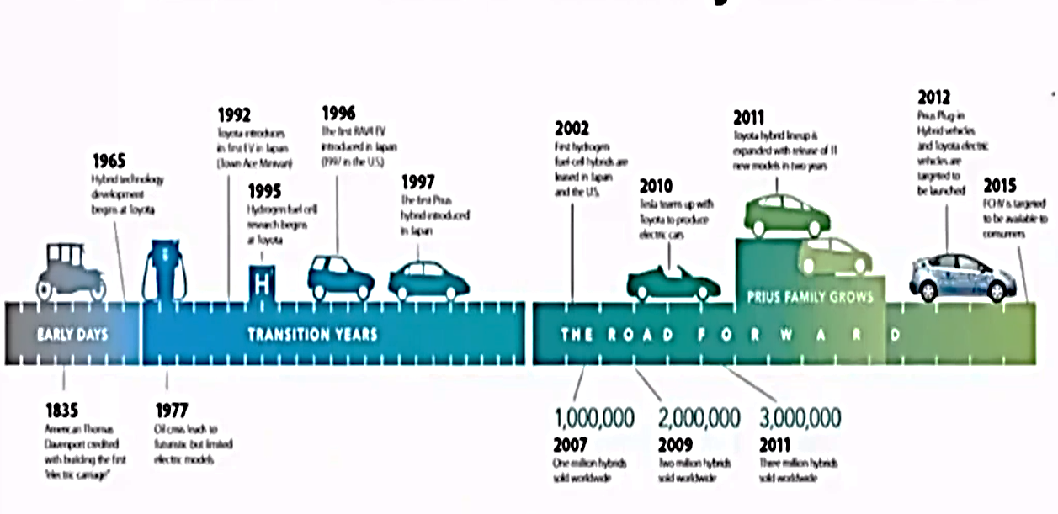
Electric Vehicles :E-Mobility Evolution

Slide 2
